Slide 1

Complete a task
Task: You need to buy a TV.
Process 2:
Browse an Online shop
Choose the TV you want to buy
Check the price.
If the price matches
Pay the price
Deliver to your Address
Else
Start from beginning.
Process 1:
Take a transport and go to market.
Find the/a store that sells TV.
Choose the TV you want to buy
Pay the price.
Bring the TV to your home.

Slide 2

CSE- 207
Algorithms
Lecture: 02
Fahad Ahmed
Lecturer, Dept. of CSE
E-mail: fahadahmed@uap-bd.edu

Slide 3
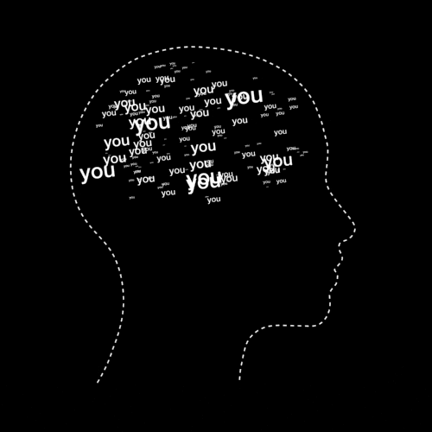
Chapter Outcomes
Basic Concepts of Algorithm
At the end of this chapter you will be able to;
Describe elements of an algorithm.
Represents an algorithm using pseudo code and flowchart.
Complexity Analysis of an algorithm.

Slide 4
Computer Program??
Computer Program
Computer Program
(Algorithm)
+
Programming language
Problem
Input
(DS)
Output
(DS)
solution
Data Structures+ Algorithms + language = Program

Slide 5
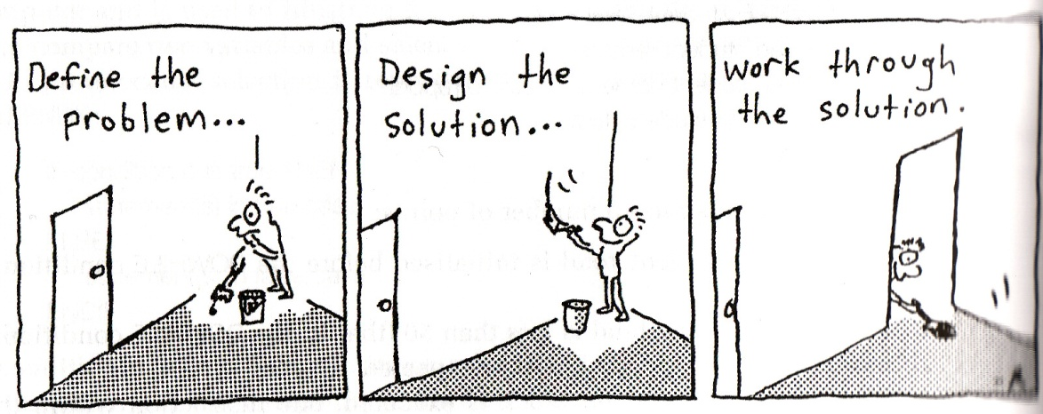
Algorithm
A program MUST be systematically and properly designed before coding begins. This design process results in the construction of an ALGORITHM.

Slide 6
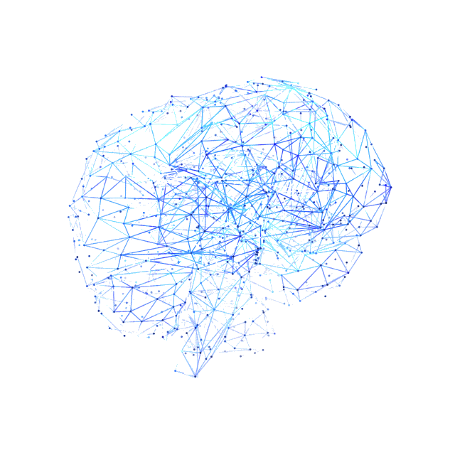
What is Algorithm – In Computer Science?
There is no general definition of algorithm accepted.
But we can say that algorithm is:
A step‐by‐step problem‐solving procedure.
A sequence of instruction that tell how to solve a particular problem.
A set of instruction for solving a problem, especially on a computer.
a sequence of computational steps that transform the input into the output.
However, most agree that algorithm has something to do with defining generalized processes to get “output” from the “input”.

Slide 7
Algorithm
Therefore, we can conclude that:
Algorithm a step‐by‐step problem solving process in which a solution is arrived in a finite amount of time
OR
An algorithm is a finite list of sequential steps specifying actions that if performed result in solution of a specific problem.
OR
It is not the complete program or code; it is just a solution (logic) of a problem, which can be represented either as an informal description using a Flowchart or Pseudocode.

Slide 8
Origin of the word “Algorithm”
Can be traced back to the 9th century
Abdullah Muhammad bin Musa al-Khwarizmi,
Persian scientist, astronomer and mathematician
Known as “The father of Algebra”
The word “Algorithm” came from his name.
In 12th century, one of his book was translated in Latin
There his name was written as “Algoritmi” in Latin, which means “the decimal number system”
In English, the word “algorithm” emerged in the 19th century.

Slide 9
When did we start using algorithm?
From the beginning of Human life, we are using algorithm at every step of our life.
But on paper – during the beginning of modern mathematics.
Euclid, Nicomachus of Gerasa expressed their ideas in step by step actions.
Euclids Life Span –Mid 4thcentury BC – Mid 3rd century BC.

Slide 10
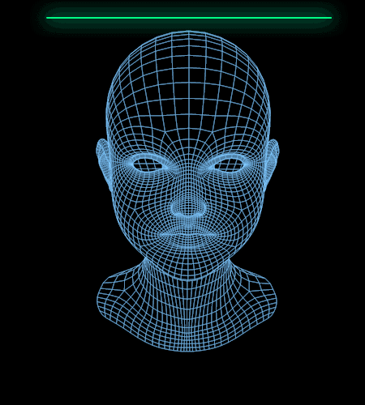
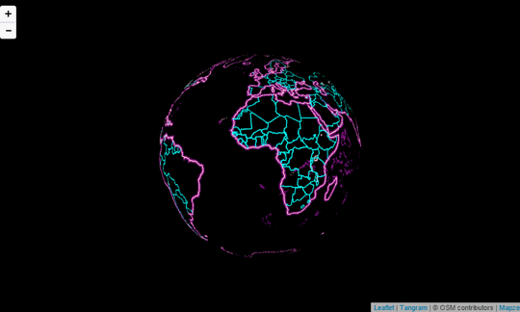
Where do we need Algorithm?
Algorithms is everywhere.
Starts with very basic mathematical/calculation algorithms
To many modern technologies (BUZZ words)
Artificial intelligence
Machine learning
Neural Network
Data Science
Block-chain
Molecular biology.

Slide 11
Where do we need Algorithm? – Example
Internet - Finding route, Search (Google)
Google Map
E-commerce
Customer pattern, market basket algorithm
Weather pattern
Sorting – Insertion Sort, Merge Sort, Bubble Sort….
Find Min(Shortest path), Max(Maximize Profit)
Scheduling
The Human Genome
Identifying all the 1,00,000 genes in human DNA
Cross matching

Slide 12
Why do we need to learn about Algorithm ?
Identifying how good an algorithm is?
When to apply an algorithm?
This will save your time and make your program faster by applying the right one.
Example (BFS vs. DFS)
How to design new algorithm?
Analyze their correctness and efficiency

Slide 13
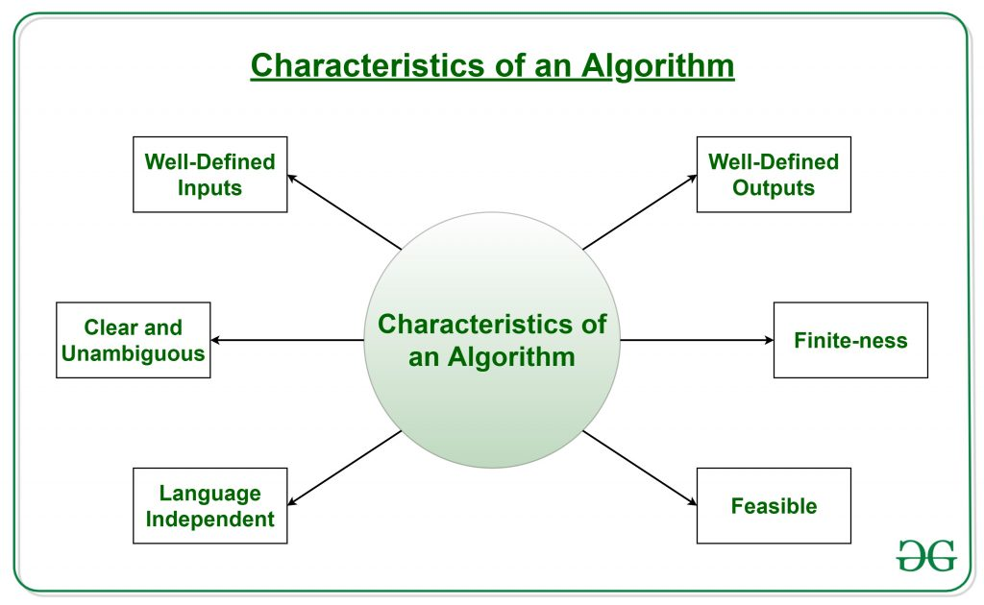
Characteristics of an algorithm
Characteristics of an Algorithm
https://www.geeksforgeeks.org/introduction-to-algorithms/

Slide 14
Characteristics of an algorithm
Characteristics of an Algorithm
Clear and Unambiguous: Algorithm should be clear and unambiguous. Each of its steps should be clear in all aspects and must lead to only one meaning.
Well-Defined Inputs: If an algorithm says to take inputs, it should be well-defined inputs.
Well-Defined Outputs: The algorithm must clearly define what output will be yielded and it should be well-defined as well.

Slide 15
Characteristics of an algorithm
Characteristics of an Algorithm
Finite-ness: The algorithm must be finite, i.e. it should not end up in an infinite loops or similar.
Feasible: The algorithm must be simple, generic and practical, such that it can be executed upon will the available resources. It must not contain some future technology, or anything.
Language Independent: The Algorithm designed must be language-independent, i.e. it must be just plain instructions that can be implemented in any language, and yet the output will be same, as expected.

Slide 16
Algorithm
Advantages of Algorithms:
It is easy to understand.
Algorithm is a step-wise representation of a solution to a given problem.
In Algorithm the problem is broken down into smaller pieces or steps hence, it is easier for the programmer to convert it into an actual program.
Disadvantages of Algorithms:
Writing an algorithm takes a long time so it is time-consuming.
Branching and Looping statements are difficult to show in Algorithms.

Slide 17

Algorithm & Logical Thinking
To develop the algorithm, the programmer needs to ask:
What data has to be fed into the computer?
What information do I want to get out of the computer?
Logic: Planning the processing of the program. It contains the instructions that cause the input data to be turned into the desired output data.

Slide 18
Algorithm Representation
There is no standard method of algorithm representation exist, however there are commonly used are:
Flowchart
graphical representation of an orderly step by step solution to a problem.
Pseudo code
Textual representations in English like to present the solution to a problem.
Tree representation
graphical representation to break problem into sub‐problem and task

Slide 19
From Algorithm to Program
Both are sets of instructions on how to do a task;
Algorithm:
talking to humans, easy to understand
in plain (English) language
Program:
talking to computer (compiler)
can be regarded as a “formal expression” of an algorithm

Slide 20
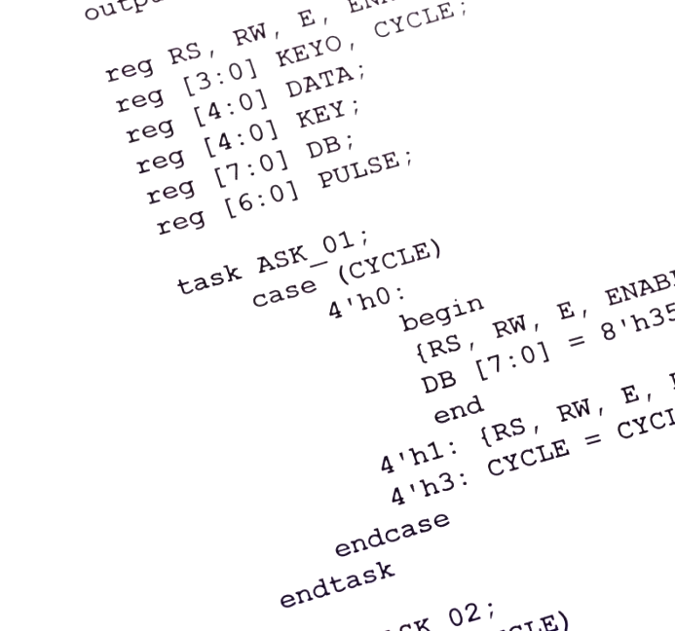


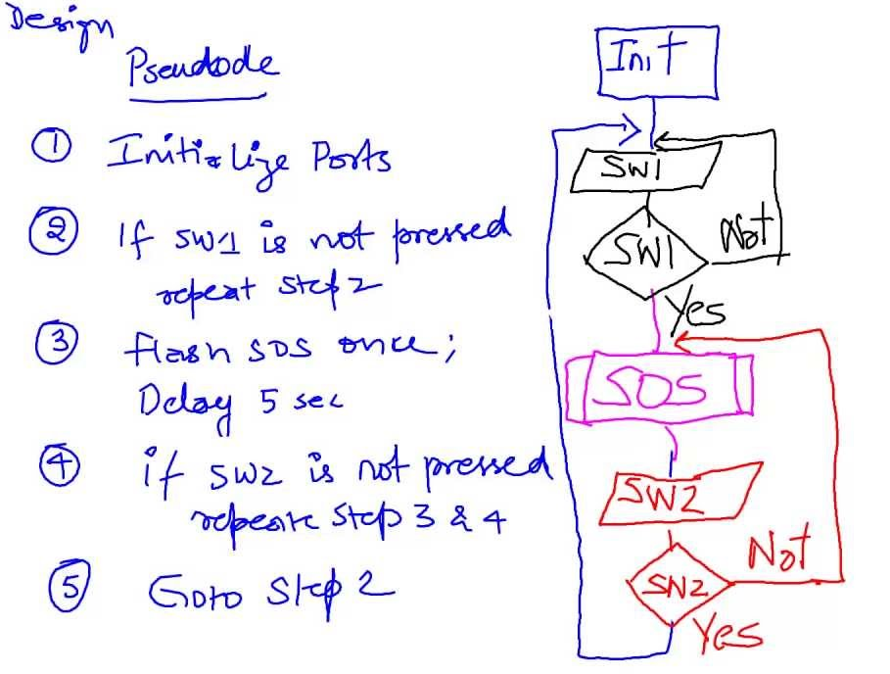


From Algorithm to Program
PROGRAM
ALGORITHM
a set of instructions which are commands to computers to perform specific operations on data
a sequence of instructions describing how to do a task (or process)

Slide 21
Algorithm & Program
Algorithm Vs Program
Algorithm
Program
A step‐by‐step problem‐solving procedure
A sequence of instruction that tell how to solve a particular problem.
A set of instruction for solving a problem, especially on a computer.
A computable set of steps to achieve a desired result.
Written in pseudo code or flowchart.
A program is a set of instructions which are commands to computers to perform specific operations on data.
Instructions within a program are organized in such a way, when the program is run on a computer; it results in the solution of a problem.
Written in any programming language

Slide 22
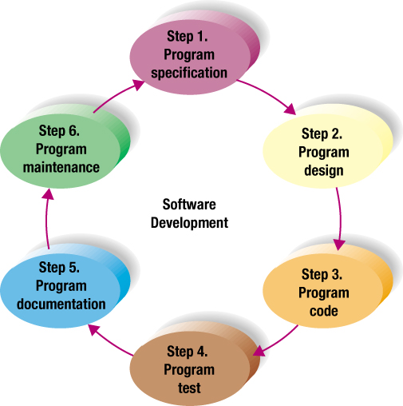
Program Development Life Cycle
Problem solving phases
Consist of problem definition and algorithm design
Phase 1: Problem Definition (Analysis)
Phase 2: Algorithm design
Phase 3: Algorithm implementation
Phase 4: Program testing
Phase 5: Program maintenance
Implementation phases
Consist of algorithm implementation, program testing and program maintenance phases.

Slide 23
Phase 1: Problem Definition (Analysis)
The problem is defined to obtain a clear understanding of the problem requirement.
It is important before come out with the solution algorithm to do the following:
Analyze the problem thoroughly.
Understand the requirement of the problem and required solution.
Divide the problem into sub‐problem if the problem is complex.
The most important and major requirement that need to be specified during problem definition (analysis):
Input
Process
Output
However, to get a complete problem specification, the following questions should be asked during problem definition (analysis):
What are the input data?
What are the output (desired) data?
What formula is to be used?
What other assumptions or constraints can be made?
What is the expected output screen?

Slide 24
Phase 2: Algorithm design
How to Design an Algorithm?
The specifications derived earlier in the analysis phase are translated into the algorithm. An algorithm is a step‐by‐step sequence of precise instructions that must terminate and describes how the data is to be processed to produce the desired outputs. The instruction may be expressed in a human language.
An algorithm must satisfy some requirements:
Input : It must have zero or more input
Output : It must produce at least one output.
Definiteness : Every step in algorithm must be clear as to what it is supposed to do
and how many times it is expected to be executed.
Effectiveness : It must be correct and efficiently solve the problem for it is designed.
Finiteness : It must execute its instruction and terminate in a finite time.

Slide 25
Algorithm Representation
Almost every program involves the steps of input, processing, and output.
Therefore graphical representation are needed to separate these three steps.
An algorithm can be written or described or represent using several tools:
Pseudo code
Use English‐like phrases to describe the processing process. It is not standardized since every programmer has his or her own way of planning the algorithm.
Flowchart
Use standardized symbol to show the steps the computer needs to take to accomplish the program’s objective. Because flowcharts are cumbersome to revise, they have fallen out of favor by professional programmers. Pseudo code, on the other hand, has gained increasing acceptance.

Slide 26
Flowchart Symbol and Description
Flowchart Symbol and Description
Name | Symbol | Description
Lozenge |  | Indicates the starting or ending of flowchart (start / stop : terminal )
Connector |  | Used to connect break in the flowchart
Parallelelogram |  | Use for input and output operation (data)
Rectangle |  | Indicates any interval operation (process)
Diamond |  | Use for asking questions that can have either TRUE of FALSE / YES or NO (decision / selection)
Module |  | Sub solution to solve a part of entire problem
Control flow |  | Shows flow direction

Slide 27
Flowchart Logic Structure
Flowchart Logic Structure
Sequence Structure | Selection Structure | Loop Structure
IF
(test condition)
statement
Yes
No
LOOP
(statement)
THEN
(statement)
ELSE
(statement)
statement
DO WHILE
(test condition)
Yes
No
DO WHILE

Slide 28
Flowchart Example
Design an algorithm to find the area of a rectangle
The formulas: area = length * width
Input | Process | Output
Input variable: length width | Processing item: area Formula: area = length x width Step / Solution algorithm: get input calculate area display output | Output: area
Start
length, width
calculate area
area
End

Slide 29
Pseudo Code Style
Style 1 | Style 2 | Style 3 (Modular design)
Problem 1. Start 2. Task 3. Action 4. End | Problem 1. Start 2. Subproblem 1 Task 1,1 Action 1,1,1 Action 1,1,2 3. Subproblem 2 Task 1,2 Action 1,2,1 Action 1,2,2 4. End | Problem 1. Start 2. Subproblem 1 3. Subproblem 2 4. End 2. Subproblem 1 Task 1,1 Action 1,1,1 Action 1,1,2 3. Subproblem 2 Task 1,2

Slide 30
Pseudo Code Example
Design an algorithm to find the area of a rectangle
The formulas: area = length * width
Input | Process | Output
Input variable: length width | Processing item: area Formula: area = length x width Step / Solution algorithm: get input calculate area display output | Output: area
Start
Read length
Read width
Calculate area of a rectangle
Display area of a rectangle
End
Start
Input length
Input width
Calculate area of a rectangle
Output area of a rectangle
End
OR
Start
Prompt the user to enter a length of a rectangle
Prompt the user to enter a width of a rectangle
Calculate the area of a rectangle
Display the area of a rectangle
End
OR

Slide 31
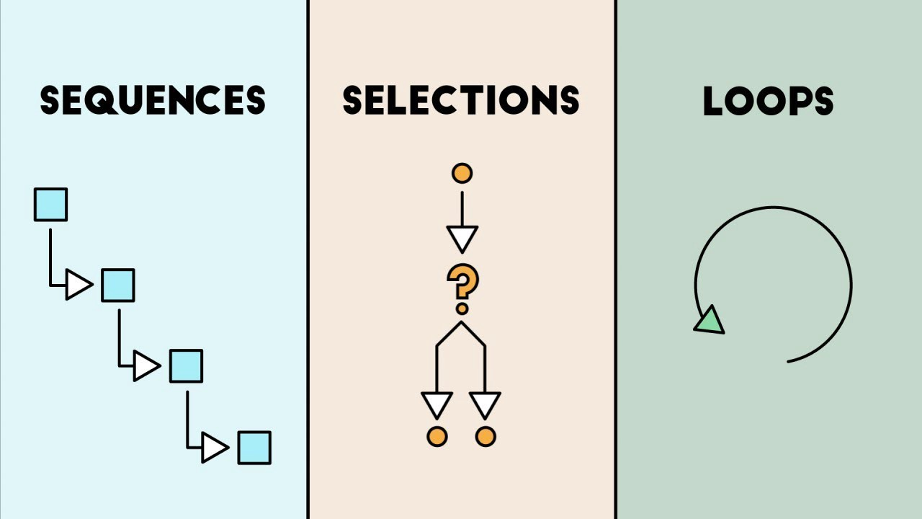
Sequence Structure
With sequence structure, an action or event is performed in order, one after another.
A sequence can contain any number of events but there is no chance to branch off and skip any of the events.
Once you start a series of events in a sequence, you must continue step‐by‐step until the sequence ends.

Slide 32
Sequence Example
Problem
Design a software to calculate the sum of two numbers entered by user.
Step : Program Specification
Understand what the problem is? What is needed to solve it? What solution should provide for the problem? Input to the problem Expected output Any special constraints/condition/ formulas to be used

Slide 33
Sequence Example
Problem
Design a software to calculate the sum of two numbers entered by user.
Input | Process | Output
Input variable: num1 num2 | Processing item: sum Formula: sum = num1 + num2 Step / Solution algorithm: get input calculate sum display output | Output: sum

Slide 34
Sequence Example
Problem
Design a software to calculate the sum of two numbers entered by user.
Pseudo Code
Simple Design
Modular Design
Simple Design
Start
Get input
Read num1
Read num2
3. Calculate sum
sum = num1 + num2
4. Display output
Print sum
5. End
Modular Design
Start
get_input()
3. calculate_sum()
4. display_output()
5. End
2. get_input()
Read num1
Read num2
3. calculate_sum()
sum = num1 + num2
4. display_output()
Print sum

Slide 35
Sequence Example
Problem
Design a software to calculate the sum of two numbers entered by user.
Flowchart
Simple Design
Modular Design
Sub-Module
Simple Design
Modular Design
start
Start
Start
Read num1
Read num2
Read num1, num2
get_input()
Return
Start
calculate sum
calculate_sum()
calculate sum
Print sum
display_output()
Return
Start
end
End
Print sum
Return

Slide 36

Thanks to All

